Slide 1
DISTRIBUTED SYSTEMS
Principles and Paradigms
Second Edition
ANDREW S. TANENBAUM
MAARTEN VAN STEEN
Chapter 6
Synchronization

Slide 2
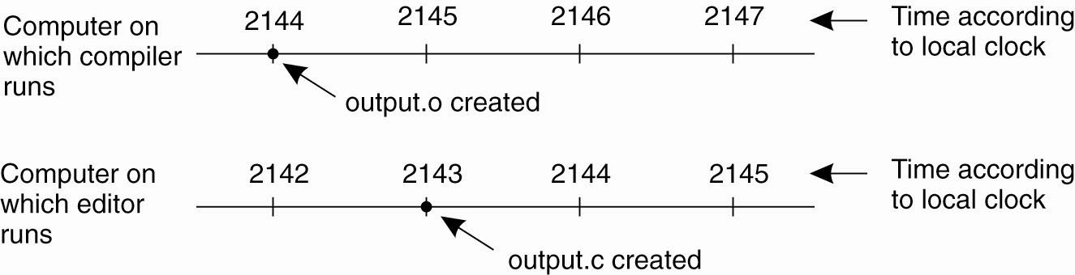
Clock Synchronization
Figure 6-1. When each machine has its own clock, an event that occurred after another event may nevertheless be assigned an earlier time.

Slide 3
Physical Clocks (1)
Some Basic definitions:
Transit of the Sun:
  Sun rises from east
  Rises to its max height in the sky (noon)
  Sun sets in west
Solar Day: Interval between 2 consecutive transits of the sun (noon-to-noon)
Solar Day varies due:
  Core activities of earth
  Rise & Tide of oceans
  Gravity
  Orbit around the sun, not a perfect circle

Slide 4
Physical Clocks (2)
Some Basic definitions – cont’d:
Before 1948: Solar day was used to measure time
1 day = 24hr x 60min x 60s = 86,400 sec)
After 1948: Measure time by counting the transitions in the Cesium 133 atom (i.e. the Second defined to be the time it takes to do 9,192,631,770 transitions). This is called TAI (International Atomic Time, measured in Paris by “Bureau International De I’Heure”, BIH)

Slide 5
Physical Clocks (3)
Problem: 1 Day measured in TAI (i.e. 86, 400 TAI sec) is 3 msec shorter than a solar day, hence the need for a leap second
Leap Second: When discrepancy between solar and TAI second is 800 msec
This correction (i.e. addition of a leap second, yield to a Universal Coordinated Time, UTC)

Slide 6
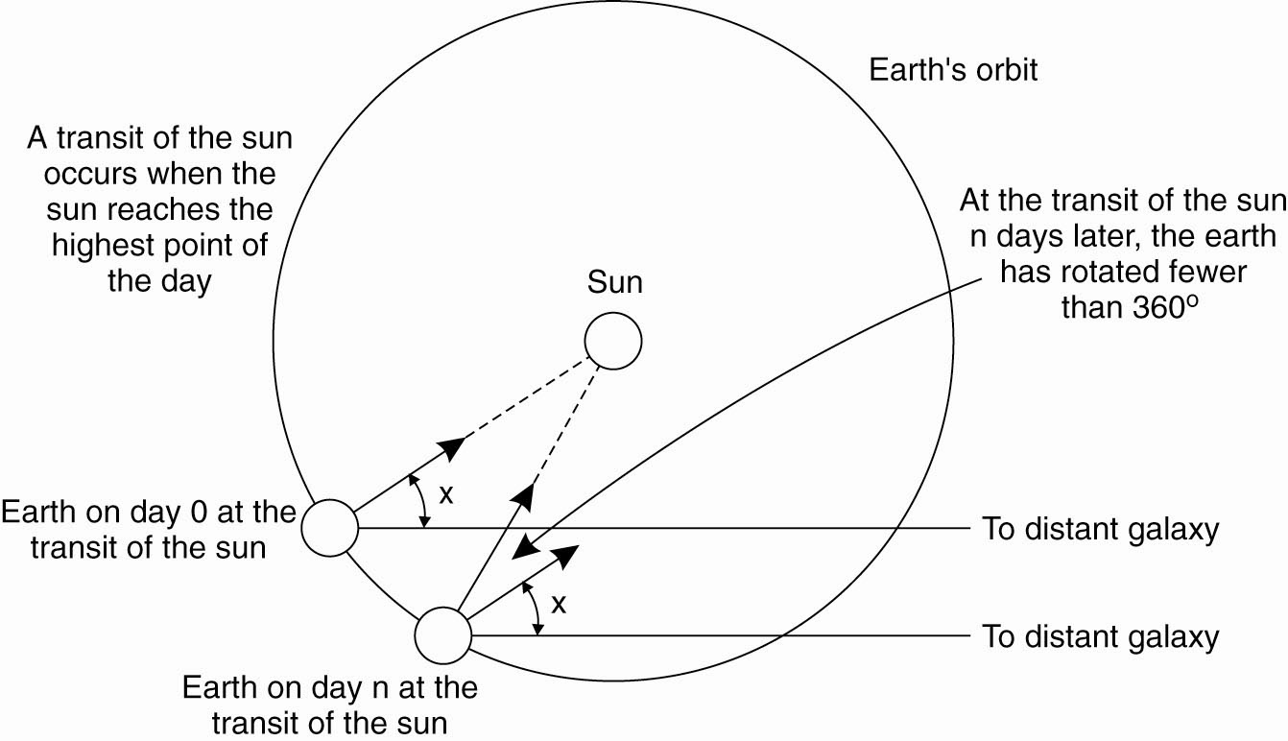
Physical Clocks (4)
Figure 6-2. Computation of the mean solar day.

Slide 7
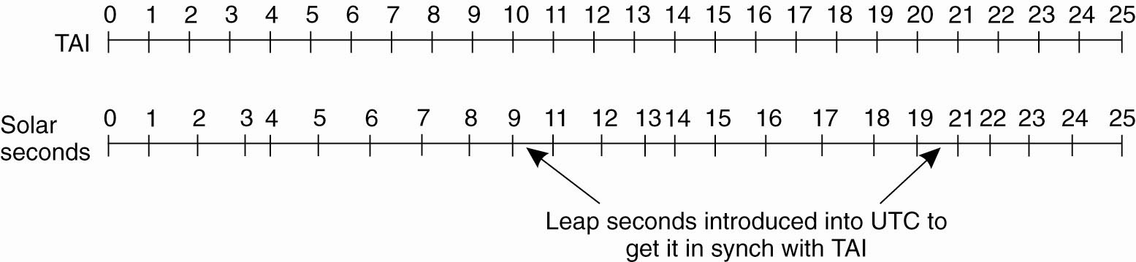
Physical Clocks (5)
Figure 6-3. TAI seconds are of constant length, unlike solar seconds. Leap seconds are introduced when necessary to keep in phase with the sun.

Slide 8
Global Positioning System (1)
Used to locate a physical point on earth
A satellite-based distributed system launch in 1978
Originally for military purposes
GPS currently uses 29 satellites orbiting the earth at a height of approximately 2000 Km each having clocks and broadcasting its position
Need at least 3 satellites to measure: Longitude, Latitude, and Altitude (height)

Slide 9
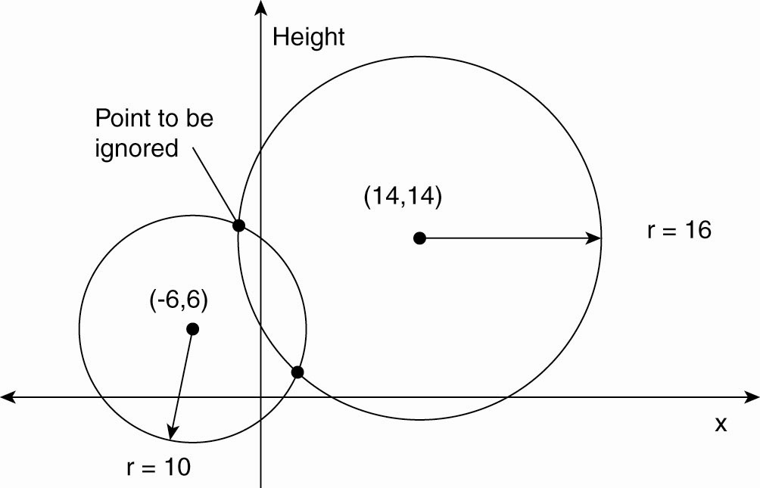
Global Positioning System (2)
Figure 6-4. Computing a position in a two-dimensional space.

Slide 10
Global Positioning System (3)
Real world facts that complicate GPS
It takes a while before data on a satellite’s position reaches the receiver.
The receiver’s clock is generally not in synch with that of a satellite.

Slide 11
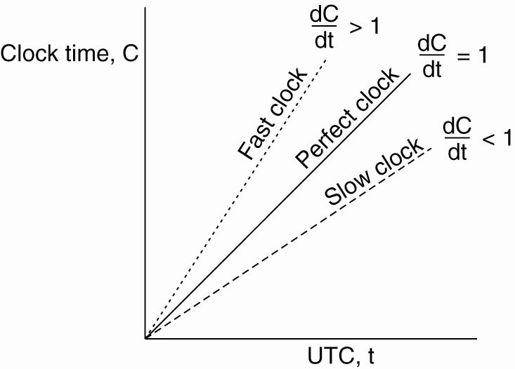
Clock Synchronization Algorithms
Figure 6-5. The relation between clock time and UTC
when clocks tick at different rates.

Slide 12
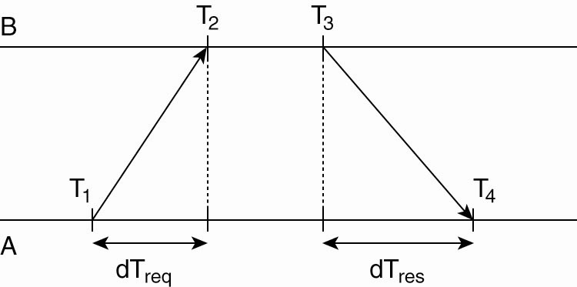
Network Time Protocol (NTP)
Figure 6-6. Getting the current time from a time server.

Slide 13
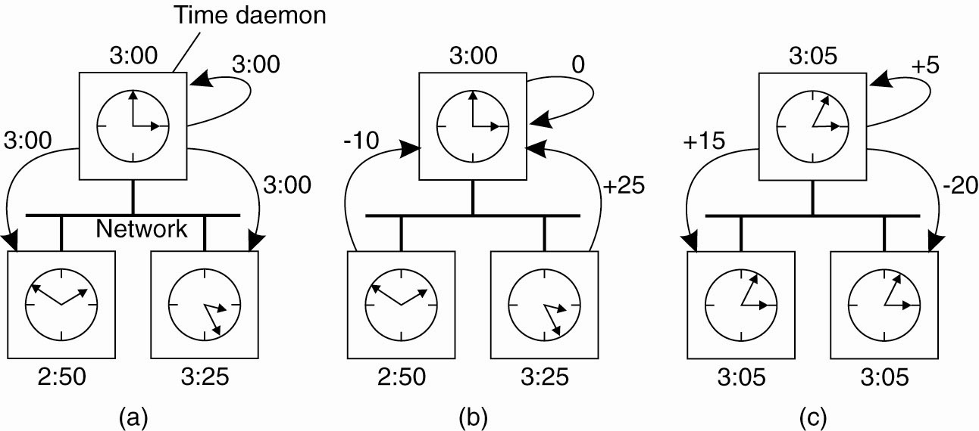
The Berkeley Algorithm (1)
Figure 6-7. (a) The time
daemon asks all the other
machines for their clock
values.

Slide 14
The Berkeley Algorithm (2)
Figure 6-7.
(b) The machines answer.

Slide 15
The Berkeley Algorithm (3)
Figure 6-7. (c) The time
daemon tells everyone how
to adjust their clock.

Slide 16
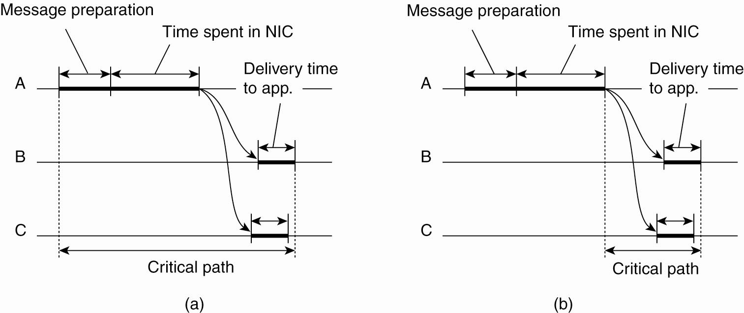
Clock Synchronization in Wireless Networks (1)
NIC: Network Interface Channel (wireless packet flows)
Figure 6-8. (a) The usual
critical path in determining
network delays.

Slide 17
Clock Synchronization in Wireless Networks (2)
RBS (Reference Broadcast Synchronization) is a clock synchronization protocol where a sender broadcasts a reference message that will allow its receivers to adjust their clocks.
RBS is also referred to as a “Point of Reference Message”

Slide 18
Clock Synchronization in Wireless Networks (3)
Figure 6-8. (b) The
critical path in the
case of RBS.

Slide 19
Lamport’s Logical Clocks (1)
The "happens-before" relation → can be observed directly in two situations:
If a and b are events in the same process, and a occurs before b, then a → b is true.
If a is the event of a message being sent by one process, and b is the event of the message being received by another process, then a → b

Slide 20
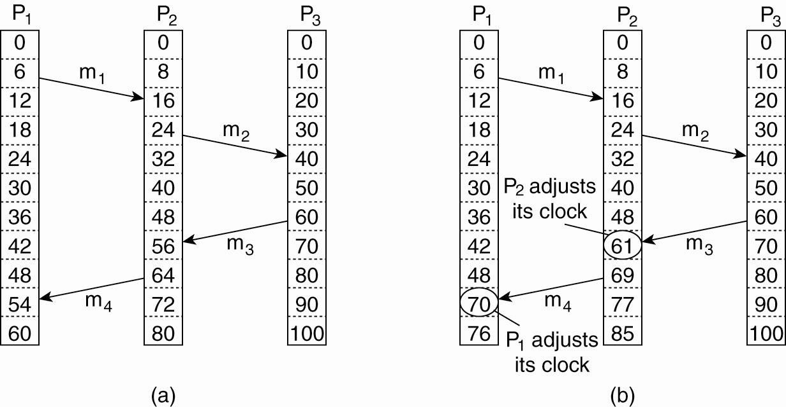
Lamport’s Logical Clocks (2)
Figure 6-9. (a) Three processes, each with its own clock.
The clocks run at different rates.

Slide 21
Lamport’s Logical Clocks (3)
Figure 6-9. (b) Lamport’s algorithm corrects the clocks.

Slide 22
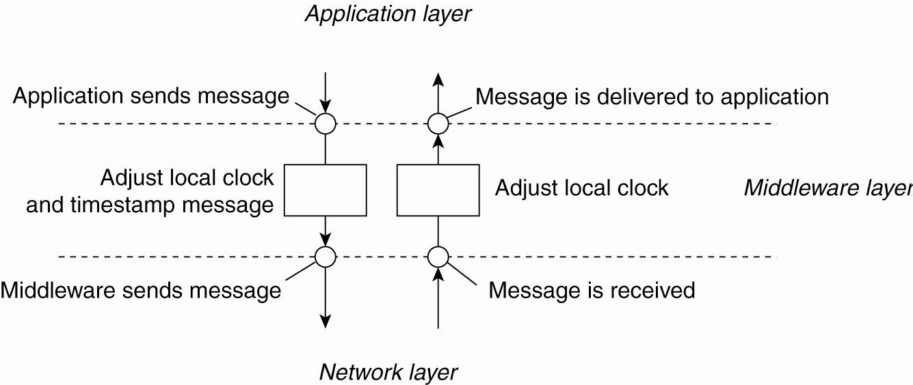
Lamport’s Logical Clocks (4)
Figure 6-10. The positioning of Lamport’s logical
clocks in distributed systems.

Slide 23
Lamport’s Logical Clocks (5)
Updating counter C_{i} for process P_{i}
Before executing an event P_{i} executes
C_{i} ← C_{i} + 1.
When process P_{i} sends a message m to P_{j}, it sets m’s timestamp ts (m) equal to C_{i} after having executed the previous step.
Upon the receipt of a message m, process P_{j} adjusts its own local counter as
C_{j} ← max{C_{j} , ts (m)}, after which it then executes the first step and delivers the message to the application.

Slide 24
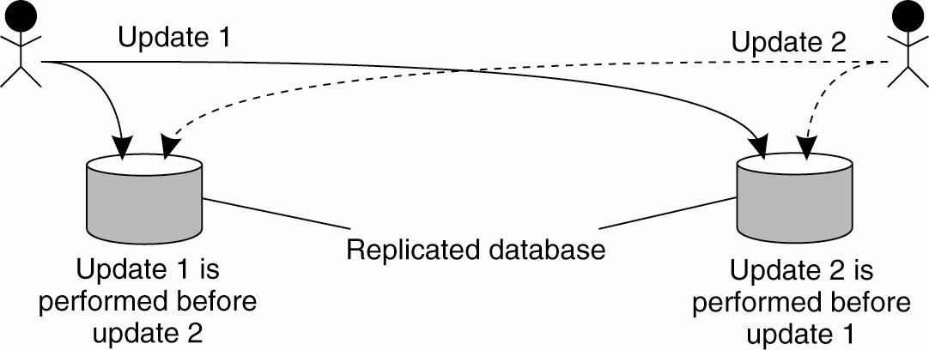
Example: Totally Ordered Multicasting (using Lamport’s logical clock)
Figure 6-11. Updating a replicated database and
leaving it in an inconsistent state.

Slide 25
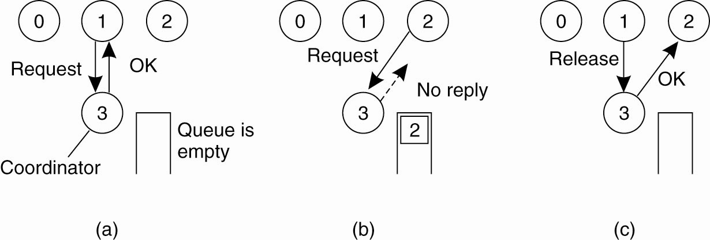
Mutual Exclusion
A Centralized Algorithm (1)
Figure 6-14. (a) Process 1 asks the coordinator for permission to access a hared resource. Permission is granted.

Slide 26
Mutual Exclusion
A Centralized Algorithm (2)
Figure 6-14. (b) Process 2 then asks permission to access the same resource. The coordinator does not reply.

Slide 27
Mutual Exclusion
A Centralized Algorithm (3)
Figure 6-14. (c) When process 1 releases the resource, it tells the coordinator, which then replies to 2.

Slide 28
A Distributed Algorithm (1)
Mutual Exclusion in access of shared resources in distributed systems
When a process wants to access a shared resource, it builds a messages containing:
  Name of the resource
  Its process number
  Current time
Then, sends the message to all other processes, even to itself

Slide 29
A Distributed Algorithm (2)
Three different cases:
If the receiver (of a message) is not accessing the resource and does not want to access it, it sends back an OK message to the sender.
If the receiver already has access to the resource, it simply does not reply. Instead, it queues the request.
If the receiver wants to access the resource as well but has not yet done so, it compares the timestamp of the incoming message with the one contained in the message that it has sent everyone. The lowest one wins.

Slide 30
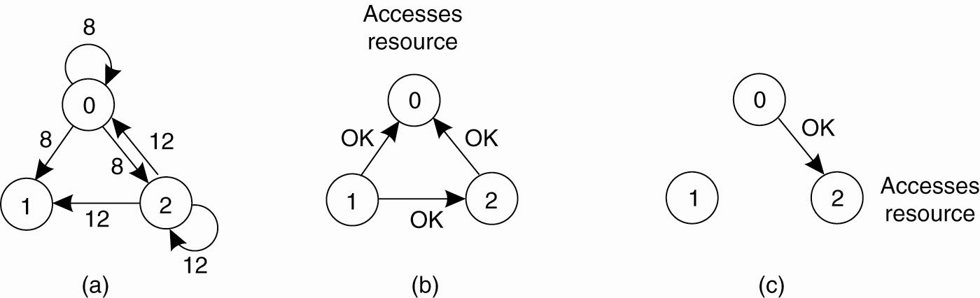
A Distributed Algorithm (3)
Figure 6-15. (a) Two processes want to access a
shared resource at the same moment.

Slide 31
A Distributed Algorithm (4)
Figure 6-15. (b) Process 0 has the lowest
timestamp, so it wins.

Slide 32
A Distributed Algorithm (5)
Figure 6-15. (c) When process 0 is done,
it sends an OK also, so 2 can now go ahead.

Slide 33
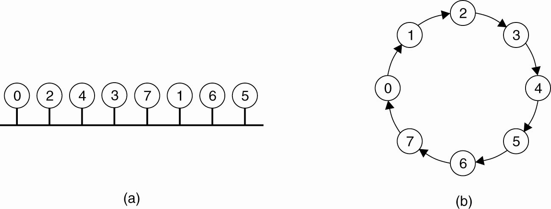
A Token Ring Algorithm (1)
Figure 6-16. (a) An unordered group of processes on a network.
(b) A logical ring constructed in software.

Slide 34
A Token Ring Algorithm (2)
When a ring is initialized, process 0 is given a token. Token is passed from k to k+1 (modulo the ring size) in a point-to-point message. When a process acquires the token from its neighbor, it checks to see if needs to access the shared resource.
Each process only needs to know who is next inline
Ordering is logical usually based on the process number or other means

Slide 35
Election Algorithms
Purpose of an Election algorithm: Elect who the next coordinating process is.
Examples of Election Algorithms:
  The Bully Algorithm
  The Ring Algorithm
  Election algorithm in Wireless network

Slide 36
The Bully Algorithm (1)
Assume every process knows the process number of other processes
Processes know each others process no., however do not know which ones are currently dead or alive
When any process, P, notices the coordinator is no longer responding to requests, it initiates an election.

Slide 37
The Bully Algorithm (2)
P sends an ELECTION message to all processes with higher numbers.
If no one responds, P wins the election and becomes coordinator.
If one of the higher-ups answers, it takes over. P’s job is done.

Slide 38
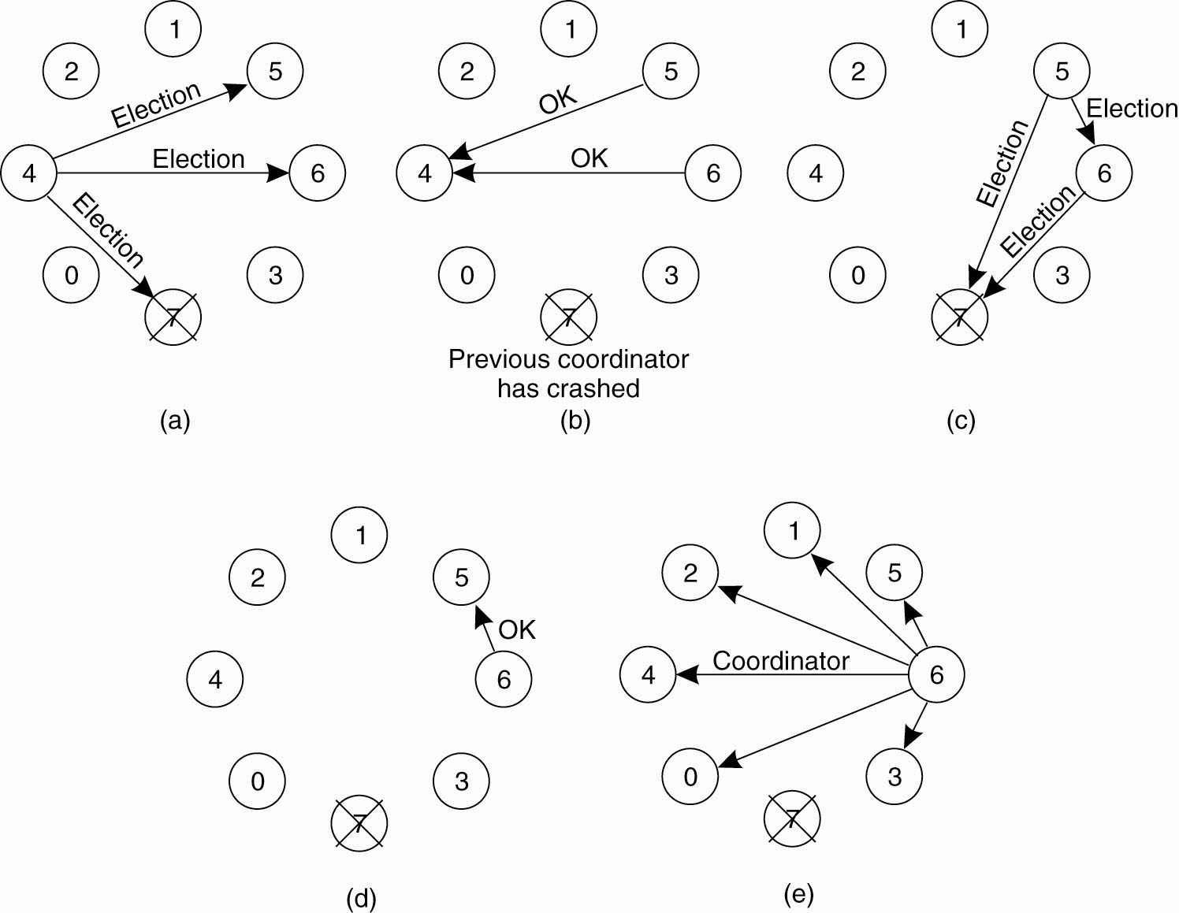
The Bully Algorithm (3)
Figure 6-20. The bully election algorithm. (a) Process 4 holds an
election. (b) Processes 5 and 6 respond, telling 4 to stop.
(c) Now 5 and 6 each hold an election.

Slide 39
The Bully Algorithm (4)
Figure 6-20. The bully election algorithm. (d) Process 6 tells 5 to stop. (e) Process 6 wins and tells everyone.

Slide 40
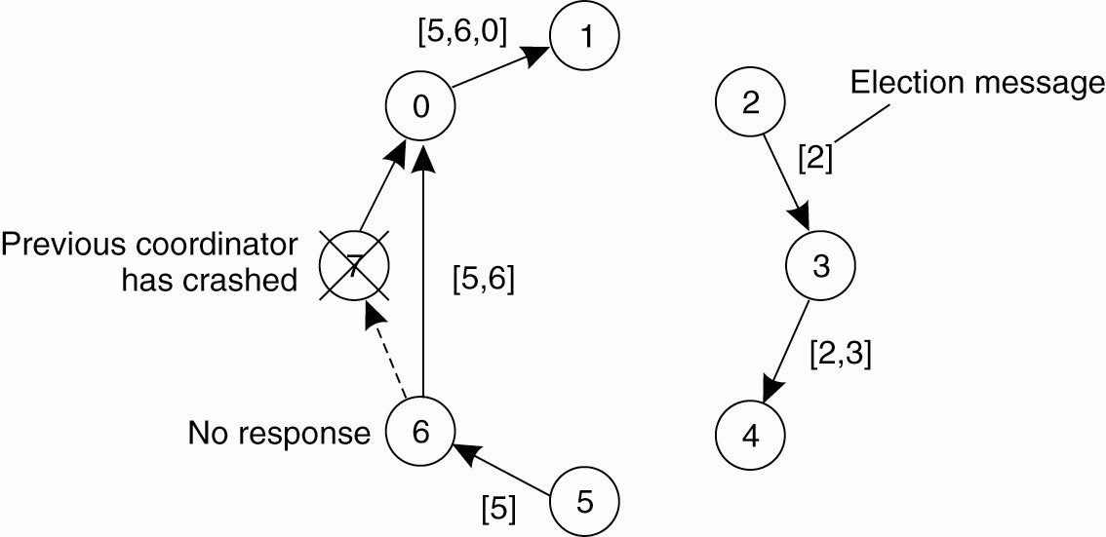
A Ring Algorithm (1)
Figure 6-21. Election algorithm using a ring.

Slide 41
A Ring Algorithm (2)
No Token is used
Both process 2 and 5, realize that the coordinator, 7, is dead
They send an election message across the ring to the next node, if node is dead, send to the one after
Either 2 or 5 becomes the new coordinator depending who sees his number come back to it first

Slide 42
Elections in Wireless Environments (1)
Bully or Ring algorithms are not realistic in wireless environments since they assume message passing is reliable which is not true in wireless environments
Purpose is to select the best node as coordinator not just any node (e.g. best capacity based on remaining battery)
Leader, called Source, can initiate an election by sending a message to its immediate neighbors

Slide 43
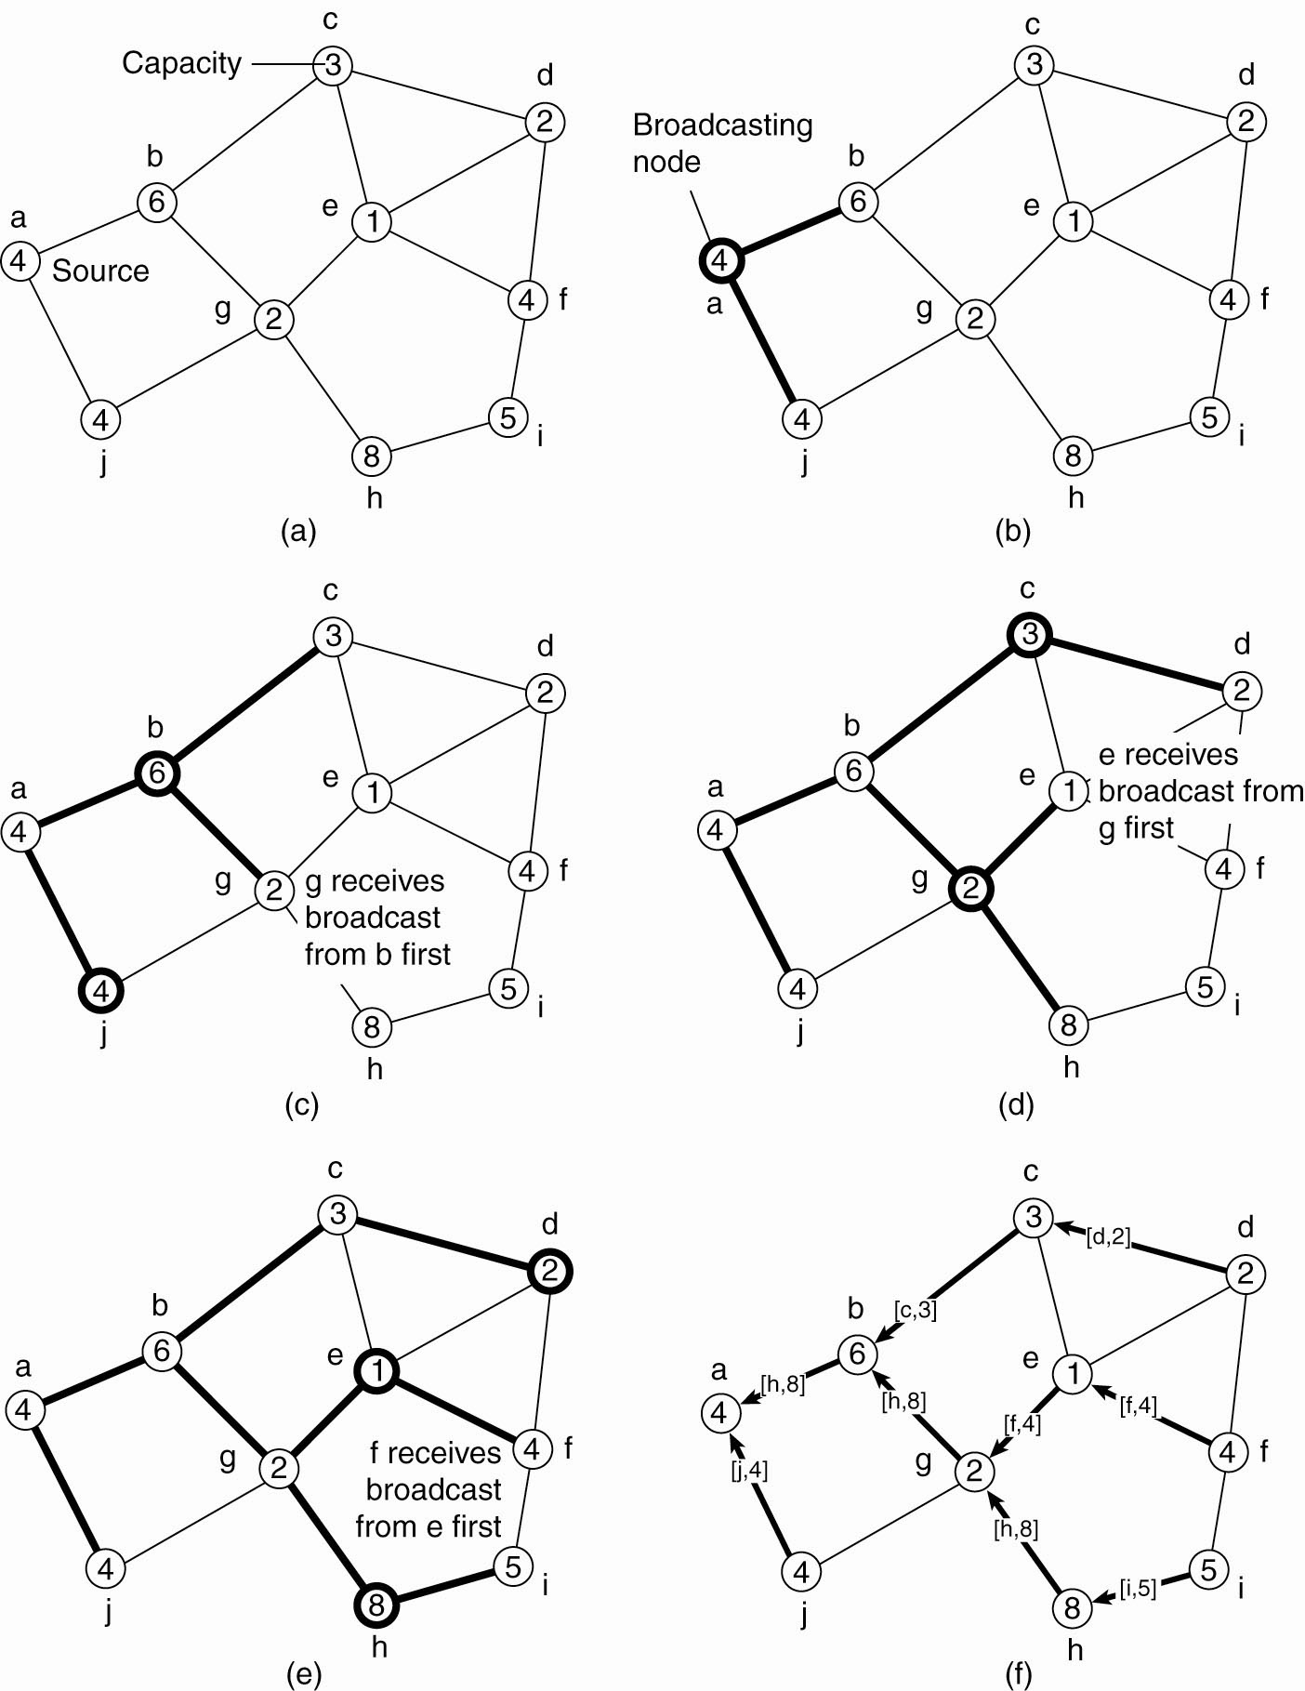
Elections in Wireless Environments (2)
Figure 6-22. Election algorithm in a wireless network, with node a as the source. (a) Initial network. (b)–(e) The build-tree phase

Slide 44
Elections in Wireless Environments (3)
Figure 6-22. Election algorithm in a wireless network, with node a as the source. (a) Initial network. (b)–(e) The build-tree phase

Slide 45
Elections in Wireless Environments (4)
Figure 6-22. (e) The build-tree phase.
(f) Reporting of best node to source.

